Slide 1
Risk Assessment and Analysis
Certified in Risk and Information Systems Control (CRISC)

Slide 2
Objectives
In this chapter you will
  Review the processes of risk identification, evaluation, and assessment
  Learn about qualitative and quantitative risk assessment techniques
  Understand how to evaluate existing controls for effectiveness
  Assess gaps between current and target states of risk in the IT environment
  Consider risk ownership and accountability during risk analysis
  Be able to report risk results to appropriate levels of management

Slide 3
Risk Assessment Processes
Assessment refers to the overall combination of steps of identifying, evaluating, and analyzing risk.
Risk Identification involves identifying the threats, vulnerabilities, assets, and
existing controls.
Evaluation focuses on determining the likelihood and impact if the vulnerabilities are exploited by the threats, resulting in damage to the asset
Risk analysis puts everything together and informs the organization about the realistic risk involved and helps determine how effective existing controls are and what gaps exist between current and desired states of risk.
Risk assessment processes may include the risk identification piece depending upon the framework or standard you are using. In general, this process includes threat source and event identification, vulnerability identification, control analysis, likelihood determination, impact analysis, risk determination, control recommendations, and results documentation.

Slide 4
Collecting Data for the Assessment
Uses a combination of four methods, designed to collect various types of qualitative and quantitative data from different sources.
Methods complement and support one another.
The four main methods of data collection are:
  Conducting interviews
  Reviewing documentation
  Observing systems and assets in operation
  Performing technical testing on assets.

Slide 5
Conducting Interviews
One of the best methods to start collecting data
Interviews should be scheduled with key personnel and consist of relevant questions that answer.
Key personnel: people with direct knowledge of important aspects of the asset, relevant threats and vulnerabilities, and controls.
Questions relating to security posture, processes and procedures, asset characteristics, and implemented security controls.
The assessor should carefully record interview results through concise meeting notes or recording devices
Interview data considered subjective in nature, but used as a starting point to gather knowledge and facts about a system that can be later verified using other.

Slide 6
Documentation Reviews
A well-documented system indicates what its characteristics, security requirements, and whether the people responsible for the system have defined processes in place to fulfill system security responsibilities.
Documentation gives information on how the system is routinely used, whether a security patch program is in place, who has access to systems and data, what policies exist to define security requirements, and how the system is securely configured.
Documentation can be either paper-based or electronic.
Documentation also serves to verify data collected from other sources, such as interviews. Remember, in the security assessor world, if you don’t document it, then you can’t prove that you do it.

Slide 7
System Observation and Verification
Observing a system in operation verify whetwhether its security functions and controls are actually working as her it is secure and intended to protect systems and data.
An assessor can easily determine whether a control is functioning by observing a system operator perform a security function or by visually inspecting a control to make sure it is in place and implemented properly.

Slide 8
System Testing
System Security testing includes:
  Various types of host-based and network scans
  In-depth examination of patches and updates, configuration settings, user accounts, and other security settings.
  Rights, permissions, and privileges examination
  Network protocols and connections are studied, and the network architecture examination.
  Application software code reviews and testing.
  Authentication and encryption mechanisms examination.
  Physical access controls testing.
The results of system security assessments are consolidated with the results from interviews, documentation reviews, and system observations to form a comprehensive data picture of the system or asset.

Slide 9
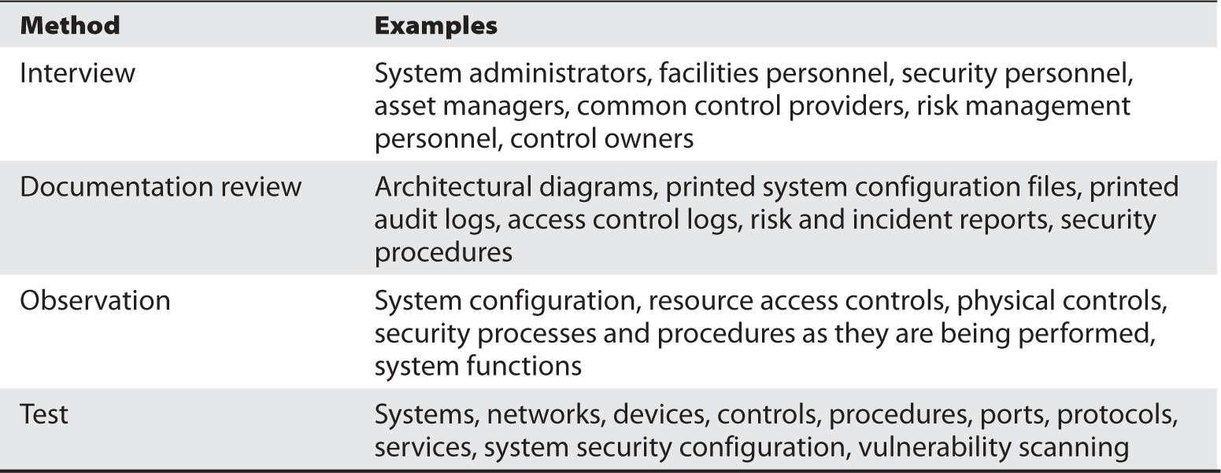
Data Collection methods
Summary of the different data collection methods you can use during an assessment.

Slide 10
Asset Identification and Categorization
Asset identification requires:
  Inventory all of your assets.
  Determine how critical they are to your business.
  Decide how sensitive the data they process or produce is.
  Characterize the system or asset in terms of confidentiality, integrity, and availability.
Determining criticality is an important aspect of the overall risk management process and done before any assessment takes place.
System categorization helps you to assign controls to the asset based on its criticality factors.
The set of controls that you assign to each asset is assessed for effectiveness in both mitigating risk and compliance.

Slide 11
Threat and Vulnerability Identification
Vulnerability Assessment: determine the vulnerabilities inherent to an asset and the threat events that could exploit those vulnerabilities.
  Information about the weaknesses inherent to an asset.
  Examining all aspects of an asset or capability to determine any vulnerability it has, including the physical, technical, and operational.
Threat assessment: determine what threats and threat agents exist that could exploit those vulnerabilities.
  internal or external or be human-made or natural threats that match a discovered vulnerability.
Consider time and location characteristics of a potential scenario.
Look at the existing controls you have in place to determine how effective they are in protecting an asset.

Slide 12
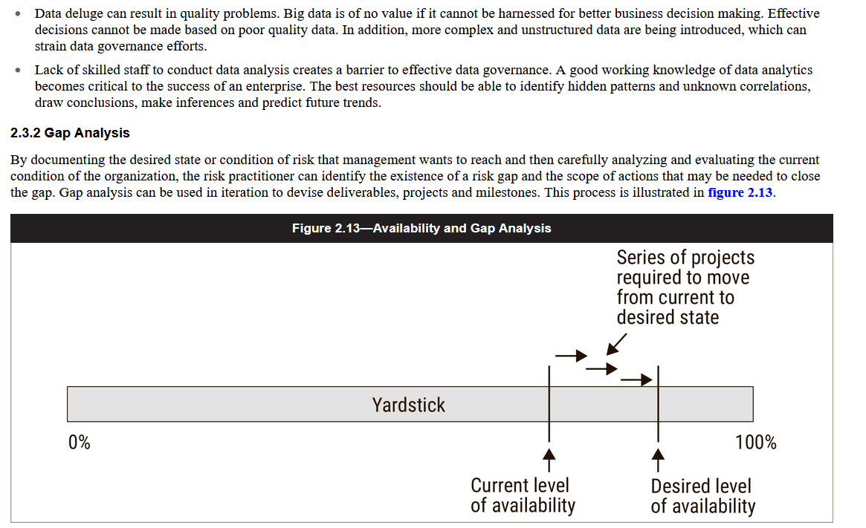
Gap Analysis
  By documenting the desired state or condition of risk that management wants to reach and then carefully analyzing and evaluating the current condition of the organization, the risk practitioner can identify the existence of a risk gap and the scope of actions that may be needed to close the gap.
  Gap analysis can be used in iteration to plan deliverables, projects and milestones.
  This process is illustrated in figure 2.13.
To measure the current state, the risk practitioner may find it beneficial to identify one or more key indicators that relate to goals or performance (i.e., [KGIs] [KPIs])
Desired states are typically linked to risk (i.e., key risk indicators [KRIs]

Slide 13
Vulnerability Assessment and Penetration Testing
  A vulnerability assessment is a careful examination of a target environment to discover any potential points of compromise or weakness.
  Vulnerabilities that may be identified by an assessment include:
      Network vulnerabilities
      Poor physical access controls ( buildings, offices)
      Insecure applications
      Poorly designed or implemented web-facing services
      Disruption to utilities (e.g., power, telecommunications)
      Unreliable supply chain
      Untrained personnel
      Inefficient or ineffective processes (e.g., change control, incident handling)
      Poorly maintained or old equipment
  Vulnerability assessment may be manual or automated however Automated tools have the ability to filter large amounts of data
  Vulnerability assessments may contain data that are not accurate, such as false positives that indicate a vulnerability where none exists.
  It is important to ensure qualified staff are executing and interpreting results from automated tools.
  Vulnerability assessments may also miss the identification of vulnerabilities that require a sequence of chained techniques to exploit.

Slide 14
  To validate the results of a vulnerability assessment, the organization may conduct a penetration test against a potential vulnerability or attack vector.
  Penetration testing can use the same sort of tools as those used by a real adversary, which can help to establish the extent to which an identified vulnerability is a true weakness.
  There are different types of penetration tests that can be performed that are based upon the enterprise appetite and end goals, which should dictate the approach that is employed in carrying out a penetration test.
  Penetration tests may be conducted by either internal or external teams or hybrid, and rules vary from full knowledge of the environment to zero-knowledge tests in which the testing team has no knowledge of the environment being attacked.
  An expert penetration testing team will be creative and attempt several types of tests to achieve their goals.
  They may exploit multiple vulnerable attack vectors or only one that gains them access.

Slide 15
  The risk practitioner can use the report generated in the process of risk identification.
  Careful consideration needs to be given to and planning is required to clearly define a penetration test engagement.
  Each penetration test is unique in nature and can include any number of activities, based on the adversary being simulated to the scope.
  The scope, time constraints, targets, exclusions and implicit authority to carry out these activities need to be clearly defined prior to having a penetration test.
  It needs to be clearly understood that the goals of vulnerability assessments and penetration tests differ in scope, nature and outcome.
  When performing a vulnerability assessment, the goal is the identification of any misconfigurations and/or vulnerabilities that may exist within a target system or application.
  Vulnerability assessments tend to be non-intrusive in nature in that they will profile the system and attempt to elicit information to determine if the system is vulnerable to an attack.

Slide 16
There are typically two types of technical vulnerability assessments: credentialed and non-credentialed.
Credentialed assessments will significantly reduce the number of potential false positives but require elevated permissions in order to run in order to understand the specific system configuration, version and patch levels applied to the system.
Non-credentialed assessments will contain a much higher number of potential false positives as they are unable to confirm the specific configuration and patch levels applied to the system.
Very little value may be gained, or benefit received in conducting a non-credentialed assessment in the grander scheme of security operations and risk management.
The purpose of a penetration test is to simulate an adversary, using intrusive methods in an attempt to circumvent controls and exploit potential vulnerabilities within an organization in order to action on objectives; the objectives are normally defined in advance of the testing and clearly stated (e.g., get to this system, exfiltrate this information, compromise this individual).
The goal of a penetration test is not to identify every potential exploitable vulnerability, but rather to discover and document how an adversary might leverage the current state environment in order to be able to accomplish their mission.

Slide 17
This difference between penetration tests and vulnerability
  Penetration tests cost more than vulnerability assessments
  Penetration tests examine the information system much more closely
  Penetration tests remove false positives from the vulnerability assessment

Slide 18
Root Cause Analysis
  Root cause analysis is a process of diagnosis to establish the origins of events so that lessons can be learned from consequences (typically errors and problems).
  The actions that an enterprise takes in response to risk are often based on the lessons learned from previous events.
  A risk practitioner examines the root cause of an incident to discover the conditions and factors that led to the event, rather than reacting to the symptoms of the problem.
  These underlying conditions, which comprise the root (core) of a problem, are the conditions against which action must be taken in order to prevent the problem from recurring.
  For example, if a review of a business process finds that users are not compliant with the procedures and policies in place, the risk practitioner should examine why the users are not compliant before recommending enforcement of the procedure.
  It may be that the procedure is outdated, flawed or unworkable when aligned with the objectives of the enterprise, in which case it is the procedure and not the behavior that should be corrected.
  Root cause analysis examines the reasons why a problem exists or a breach has occurred and seeks to identify and resolve these underlying issues.

Slide 19
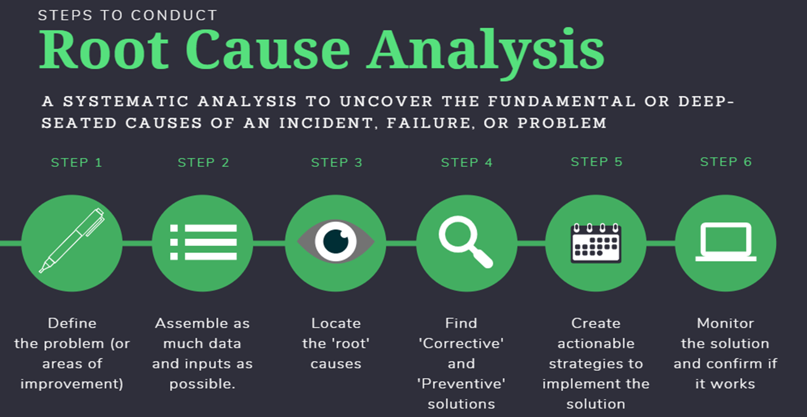

Slide 20
Likelihood Determination and Impact Analysis
Determine the likelihood of a given threat agent initiating a threat or of an identified threat exploiting a given vulnerability,
Determine the level of impact or harm to the asset if a vulnerability were successfully exploited by a threat.
Threats and vulnerabilities in assets are static, don’t change much.
Likelihood and impact are variable primary factors in measuring risk.
Evaluation involves the measurement of these two primary factors, likelihood and impact.

Slide 21
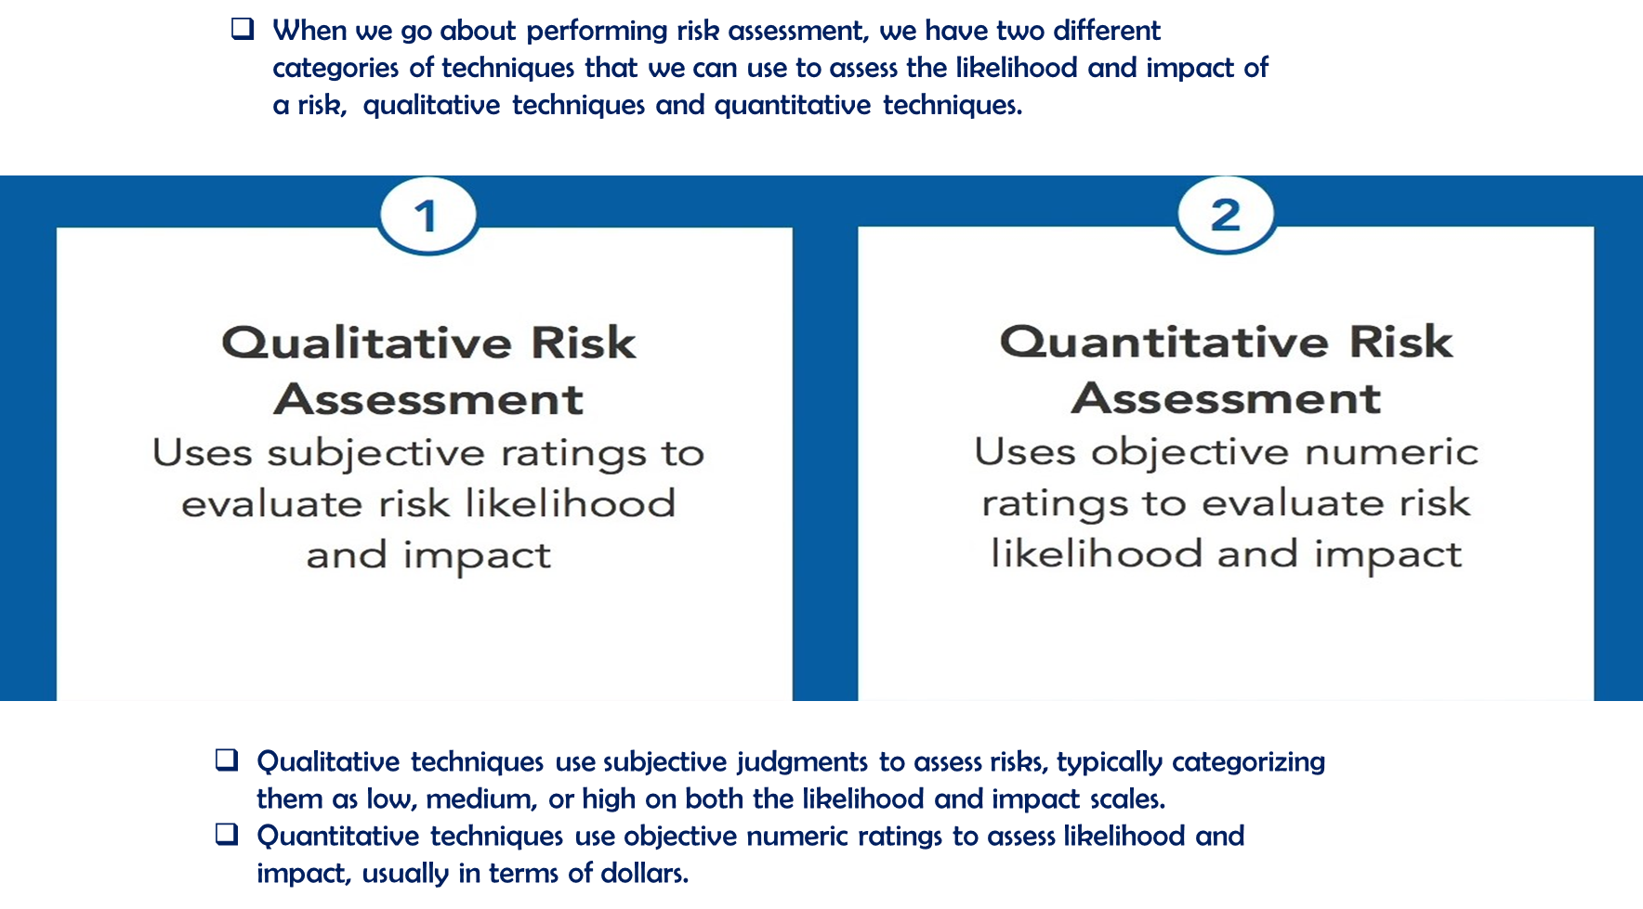
Quantitative and Qualitative Techniques
Most risk assessment methodologies are based on the two primary ways to assess risk: qualitative and quantitative.

Slide 22
Combining Quantitative and Qualitative Techniques
qualitative or quantitative assessment alone may not be enough to adequately capture the different elements of risk and develop an overall risk determination.
Each technique is good at producing a valuable piece of the puzzle, but sometimes you need both a quantitative perspective and a qualitative perspective on risk.
In practice, most risk assessments are usually qualitative with some quantitative elements to them, or vice versa. There are usually few purely quantitative or entirely qualitative assessments performed.

Slide 23
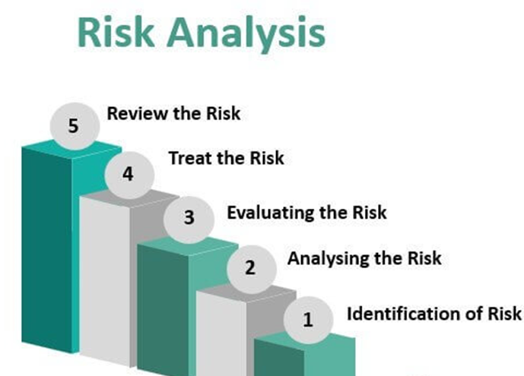
Qualitative Risk Analysis Steps
Step 1: Identify Risks
  The goal of this step is to create a master list of risks .It’s crucial to assemble a team of subject matter experts that bring direct knowledge and experience
Step 2: Classify Risks
  One popular technique is the risk matrix, which combines the consequences and likelihood of a risk occurring.
Step 3: Develop strategies to address risks based on their priority.
  After setting the priority for each risk, work with subject matter experts to come up with potential strategies to address them.
Step 4: Monitor each risk and re-evaluate.
  It’s not enough to identify risks and come up with solutions. Often, risks, their impact, and the likelihood of occurring can change. Revisit risks and make sure from the following:
      Is risk control effective?
      Were risks correctly classified?
      Have all risks been identified?

Slide 24
Qualitative Risk Analysis
RISK ANALYSIS MATRIX
The Risk Analysis Matrix allows you to perform Qualitative Risk Analysis based on likelihood (from “rare” to “almost certain”) and consequences (or impact), from “insignificant” to “catastrophic.”
The resulting scores are Low (L), Medium (M), High (H), and Extreme Risk (E).
Low risks are handled via normal processes; moderate risk require management notification; high risks require senior management notification, and extreme risks require immediate action including a detailed mitigation plan (and senior management notification).
The goal of the matrix is to identify high likelihood/high consequence risks and drive them down to low likelihood/low consequence risks
Take an example of the risk of power failure for your Datacenter
    Consequences: major
    Likelihood: unlikely
Risk of Ransomware attack
    Consequences: catastrophic
    Likelihood: possible
Risk of insider attack
    Consequences: Major
    Likelihood: possible

Slide 25
RISK = THREAT × VULNERABILITY
  Is the possibility or likelihood that a thread will exploit a vulnerability to cause harm to an asset. To have risk, a threat must connect to a vulnerability. This relationship is stated by the formula:
  Risk = Threat × Vulnerability
  You can assign a value to specific risks using this formula. Assign a number to both threats and vulnerabilities. We will use a range of 1–5 (the range is arbitrary; just keep it consistent when comparing different risks).
  Compared to Boston, the threat of an earthquake in San Francisco is higher (more frequent earthquakes), but the vulnerability is lower (stronger safety building). Boston has a lower threat (less earthquakes), but a higher vulnerability (weaker buildings). This means the two cities have roughly equal risk.
  Using a scale of 1–5, and using the risk = threat x vulnerability calculation:
  • San Francisco threat: 4 • San Francisco vulnerability: 2 • San Francisco risk: 4 × 2 = 8
  • Boston threat: 2 • Boston vulnerability: 4 • Boston risk: 2 × 4 = 8
  Another Ex…is your computer status and type of site you browse through the internet

Slide 26

Once you've identified the risks facing your organization, you probably still have a somewhat overwhelming list.
The next stage in the risk assessment process ranks those risks by two factors: likelihood and impact.

Slide 27

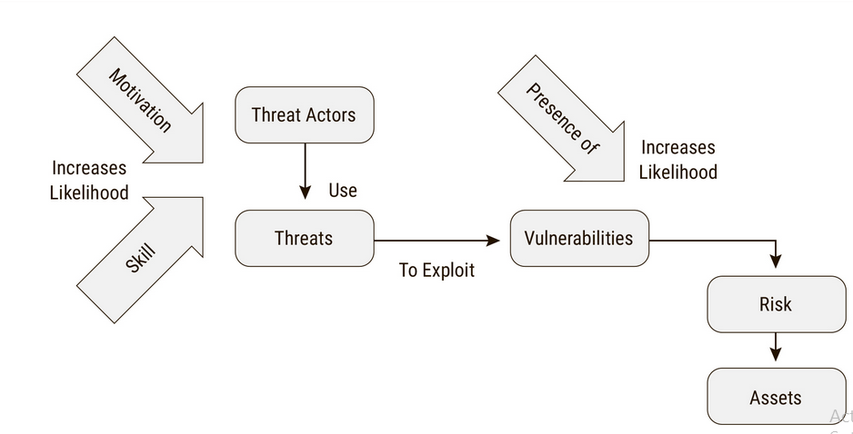

Slide 28

The impact of a risk is the amount of damage that will occur if a risk materializes.
For example, an earthquake might cause devastating damage to a data center while a rainstorm might not cause any damage at all.

Slide 29
IMPACT
  The “Risk = Threat × Vulnerability” equation sometimes uses an added variable called impact:
  “Risk = Threat × Vulnerability × Impact.” (consequences)
  Impact is the severity of the damage, sometimes expressed in dollars.
  Risk = Threat × Vulnerability × Cost
  Let’s use the “impact” formula using the same earthquake risk example for buildings.
    A company has two buildings in the same office park that are virtually identical. One building is full of people and equipment; the other is empty (awaiting future growth).
    The risk of damage from an earthquake to both is 8, using “Risk = Threat × Vulnerability.” The impact from a large earthquake is 2 for the empty building (potential loss of the building), and 5 for the full building (potential loss of human life).
    Here is the risk calculated using “Risk = Threat × Vulnerability × Impact”:
        • Empty Building Risk: 2 (threat) × 4 (vulnerability) × 2 (impact) = 16
        • Full Building Risk: 2 (threat) × 4 (vulnerability) × 5 (impact) = 40
Loss of human life has near-infinite impact on the exam. When calculating risk using the “Risk = Threat × Vulnerability × Impact” formula, any risk involving loss of human life is extremely high, and must be mitigated.

Slide 30
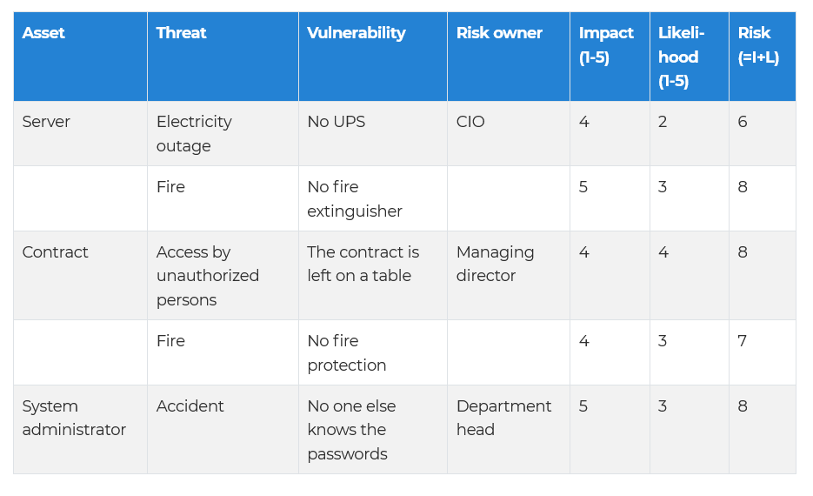
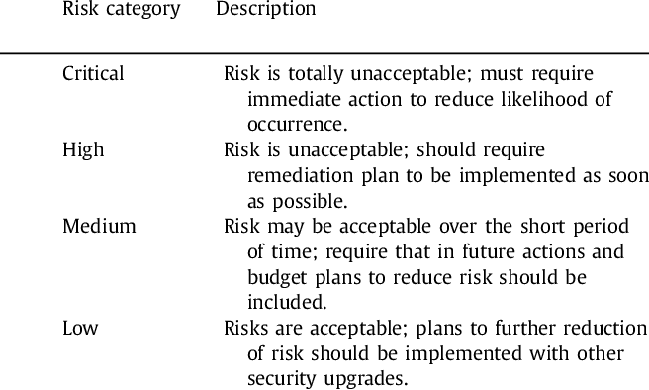
Example of risk assessment
  In the table below, you’ll see an example of a simple risk assessment using an asset-based approach.

Slide 31
Quantitative Risk Analysis is more difficult:
to quantitatively analyze the risk of damage to a data center due to an earthquake, you would need to calculate the asset value of the data center: the cost of the building, the servers, network equipment, computer racks, monitors, etc. Then calculate the Exposure Factor, and so on.
To qualitatively analyze the same risk, you would research the risk, and agree that the likelihood is a 2, and the consequences are a 4, and use the Risk Analysis matrix to determine a risk of “high.”
  You can use many techniques to perform qualitative risk analysis that include .
    Brainstorm
    Focus group
    Surveys
    One on one meting
    Interviews
    Questionaries’
    Checklist

Slide 32
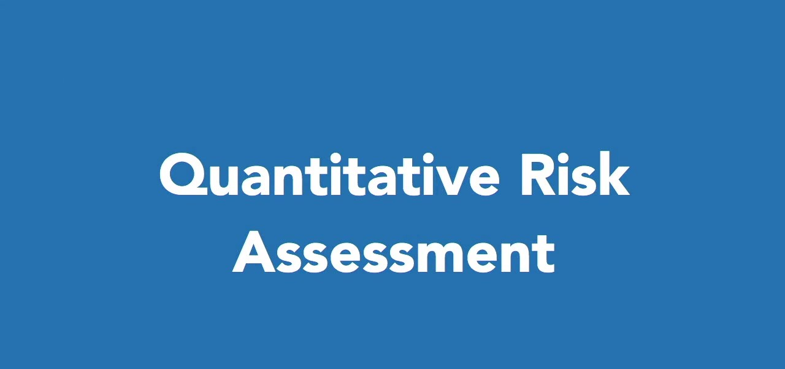

Slide 33
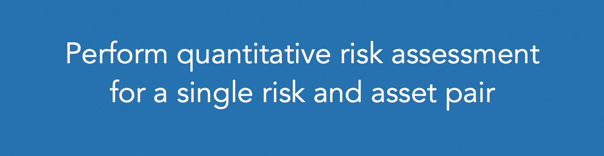
The process of using numeric data to assist in risk decisions is known as quantitative risk assessment.
Security professionals performing quantitative risk assessment do so for a single risk/asset pairing.
For example, they might conduct an assessment based upon the risk of flooding to a data center facility.

Slide 34

As they conduct this assessment, they must first determine the values for several variables.
The first of these variables is the asset value, or AV. This is, quite simply, the estimated value in dollars of the asset.

Slide 35
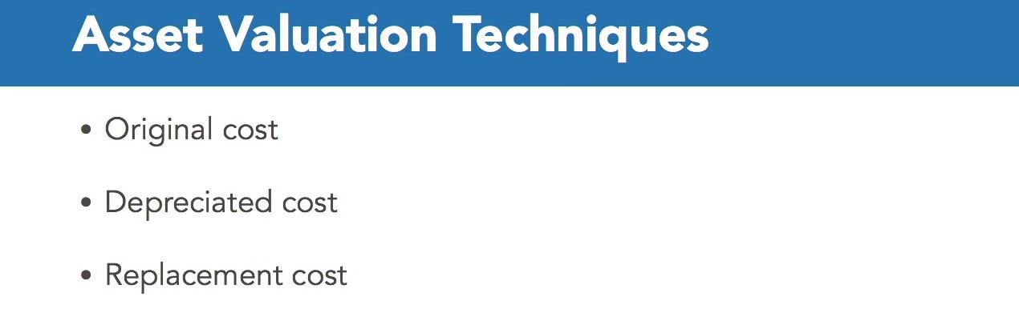
Risk assessors determining an asset's value have several options at their disposal.
The depreciation technique uses an estimate of the asset's useful life and then gradually decreases the asset value until it reaches zero at the end of its projected lifespan.
The replacement cost technique is the most popular among risk managers because it produces results that most closely approximate the actual costs that an organization will incur if a risk materializes.
The replacement cost technique goes out and looks at current supplier prices to determine the actual cost of replacing an asset in the current market and then uses that cost as the asset's value.

Slide 36

The second variable that we must consider is the exposure factor, or EF.
The exposure factor is based upon the specific risk considered in the analysis and it estimates the percentage of that asset that will be damaged if a risk materializes.
For example, if we expect a flood might damage 50% of our data center, we'd set the exposure factor for that flood to 50%.

Slide 37
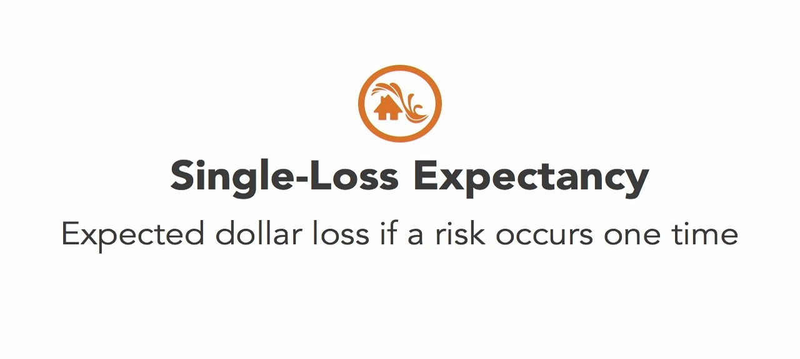
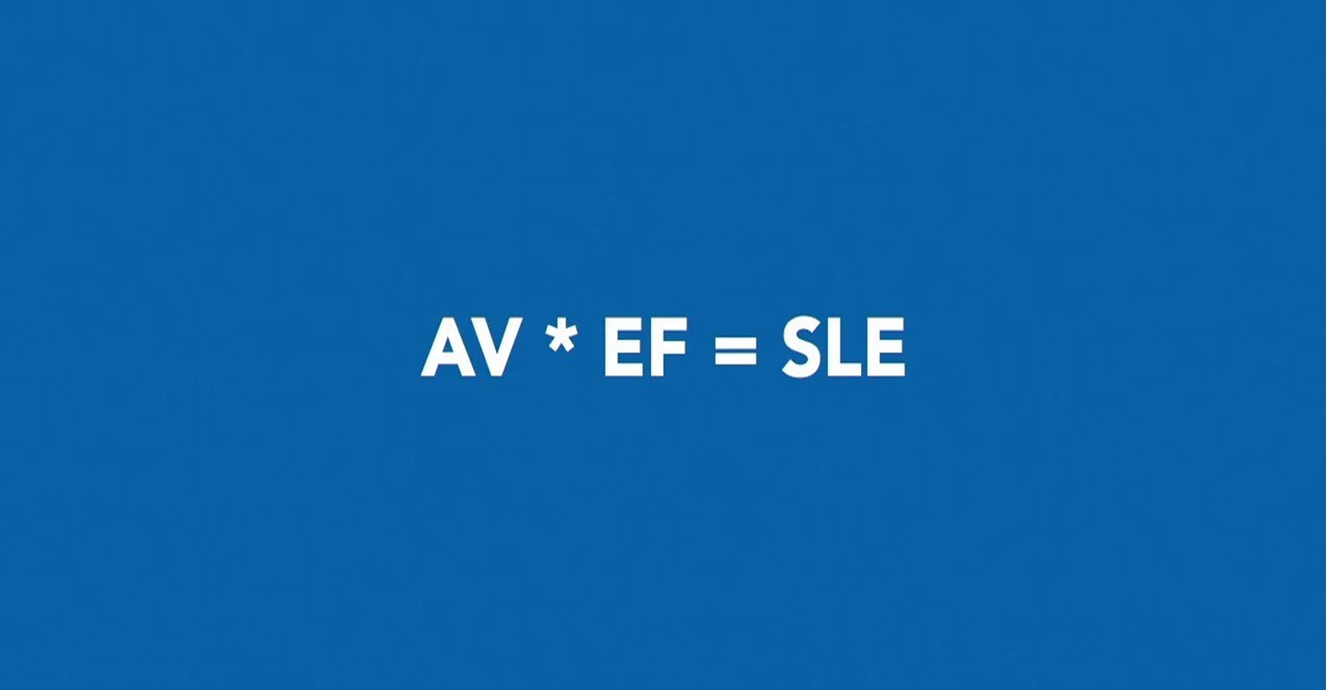

Slide 38

So, if we have a data center valued at $20 million and expect that a flood would cause 50% damage to the facility, we compute our SLE by multiplying these two numbers together and finding that a single flood would cause $10 million in damage.
That's the impact of the risk. The SLE only gives us an idea of impact.

Slide 39
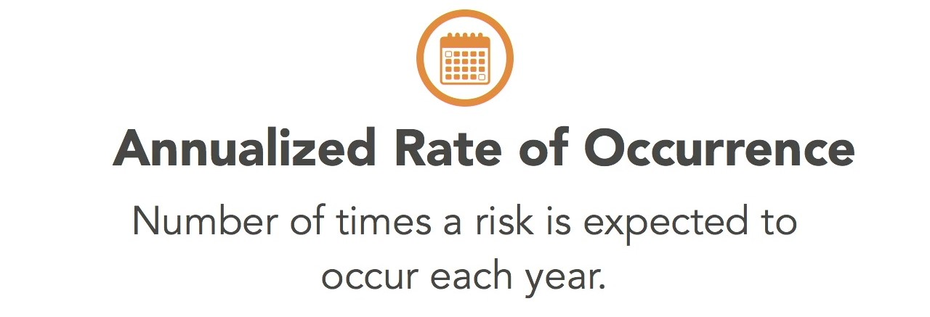
As you know, risk assessment must also consider the likelihood of a risk. That's where the annualized rate of occurrence, or ARO, comes into play.
The ARO is the number of times each year that we expect a risk to occur. In the case of a flood, we might consult Flood Maps and determine that there is a 1% annual risk of flood in the vicinity of our data center. That's the same as saying that we expect 0.01 floods to occur each year, so our ARO is 0.01.

Slide 40
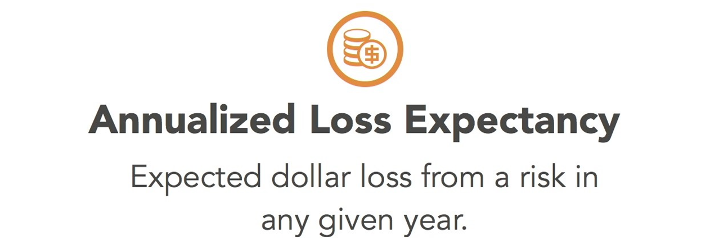

Finally, a risk analysis should incorporate both of these likelihood and impact values. We do this by computing the annualized loss expectancy, or ALE.
This is the amount of money we expect to lose each year from that risk and it's a good measure of the overall risk to the organization.

Slide 41

In the case of flood risk to our data center, the SLE was $10 million and the ARO was 0.01 Multiplying these together, we get an annualized loss expectancy of $100,000. This means that we should expect to lose $100,000 each year from the risk of flooding to our data center
It is important to remember that in reality, this cost won't occur each year. What will really have happened is $10 million in damage each time a flood occurs, but since we expect that to happen only once every 100 years, it averages out to $100,000 a year.

Slide 42
Let’s calculate the monetary value of the risk for your organization due to “losing or Stolen laptops with an average value of $22,500 for the personal records PII Exist on the laptops”.
We think there is a chance of losing 11 laptops each year in our organization, and the laptop itself cost $2,500.
Now let’s see how we can calculate the annual loss expectancy which would be our overall quantified risk.
Asset Value (AV): $2,500 (Laptop) + $22,500 (PII data) = $25,000
Exposure Factor ( loss potential )
  The Exposure Factor (EF) is the percentage of value an asset lost due to an incident. In the case of a stolen laptop with unencrypted PII, the Exposure Factor is 100%: the laptop and all the data are gone.
Single Loss Expectancy
  The Single Loss Expectancy (SLE) is the cost of a single loss. SLE is the Asset Value (AV) times the Exposure Factor (EF). In our case, SLE is $25,000 (Asset Value) times 100% (Exposure Factor), or $25,000.
Annual Rate of Occurrence
  The Annual Rate of Occurrence (ARO) is the number of losses you suffer per year. Looking through past events, you discover that you have suffered 11 lost or stolen laptops per year on average. Your ARO is 11.
Annualized Loss Expectancy
  The Annualized Loss Expectancy (ALE) is your yearly cost due to a risk. It is calculated by multiplying the Single Loss Expectancy (SLE) times the Annual Rate of Occurrence (ARO). In our case, it is $25,000 (SLE) times 11 (ARO), or $275,000.

Slide 43
Perform cost/benefit analysis of Countermeasure
1. Calculate TOTAL COST OF OWNERSHIP
  The Total Cost of Ownership (TCO) is the total cost of a mitigating safeguard.
  TCO combines upfront costs (often a one-time capital expense) plus annual cost of maintenance, including staff hours, vendor maintenance fees, software subscriptions, etc. These ongoing costs are usually considered operational expenses.
  Using our laptop encryption example, the upfront cost of laptop encryption software is $100/laptop, or $100,000 for 1000 laptops. The vendor charges a 10% annual support fee, or $10,000/year. You estimate that it will take 4 staff hours per laptop to install the software, or 4000 staff hours. The staff that will perform this work makes $50/hour plus benefits. Including benefits, the staff cost per hour is $70, times 4000 hours, that is $280,000.
  Your company uses a 3-year technology refresh cycle, so you calculate the Total Cost of Ownership over 3 years:
    • Software cost: $100,000
    • Three year’s vendor support: $10,000 × 3 = $30,000
    • Hourly staff cost: $280,000
    • Total Cost of Ownership over 3 years: $410,000
    • Total Cost of Ownership per year: $410,000/3 = $136,667/year
Your Annual Total Cost of Ownership for the laptop encryption project is $136,667 per year.

Slide 44
2. Calculate RETURN ON INVESTMENT
  The Return on Investment (ROI) is the amount of money saved by implementing a safeguard.
  If your annual Total Cost of Ownership (TCO) is less than your Annualized Loss Expectancy (ALE), you have a positive ROI (and have made a good choice). If the TCO is higher than your ALE, you have made a poor choice.
  The annual TCO of laptop encryption is $136,667; the Annualized Loss Expectancy for lost or stolen unencrypted laptops is $275,000
  The lower Exposure Factor lowers the Annualized Loss Expectancy from $275,000 to $27,500
  You will save $247,500/year (the old ALE, $275,000, minus the new ALE, $27,500) by making an investment of $136,667.
  Your ROI is $110,833 per year ($247,500 minus $136,667). The laptop encryption project has a positive ROI, and is a wise investment.
Annualized Loss Expectancy of Encrypted Laptops

Slide 46
QUANTITATIVE AND QUALITATIVE RISK ANALYSIS
  Quantitative and Qualitative Risk Analysis are two methods for analyzing risk.
  Quantitative Risk Analysis uses hard metrics, such as dollars. Qualitative Risk Analysis uses simple approximate values. Quantitative is more objective; qualitative is more subjective.
  Hybrid Risk Analysis combines the two: using quantitative analysis for risks which may be easily expressed in hard numbers such as money, and qualitative for the remainder.

Slide 47
Business Impact Analysis
Business impact analysis (BIA) is a critical step in developing the business continuity strategy and the subsequent implementation of the risk countermeasures and the BCP in particular.
BIA is used to evaluate the critical processes (and IT components supporting them) and to determine time frames, priorities, resources and interdependencies.
Often, the BIA uncovers some less visible, but vital, component that supports the critical business process.
Outcomes associated with completing a BIA include:
  The ability to prioritize business defined critical services, which support strategic priorities, goals and objectives
  The ability to determine how business critical services should be protected
  The ability to define the acceptable levels of diminished operation before impacting strategic priorities
  The ability of the organization to achieve its goal and objectives.
These abilities can then be transformed into defining:
  The business activities and resources required to achieve the enterprise strategy
  What needs to be protected and order of recovery following an incident
  Recovery timeframes that in turn can inform when services need to be recovered

Slide 48
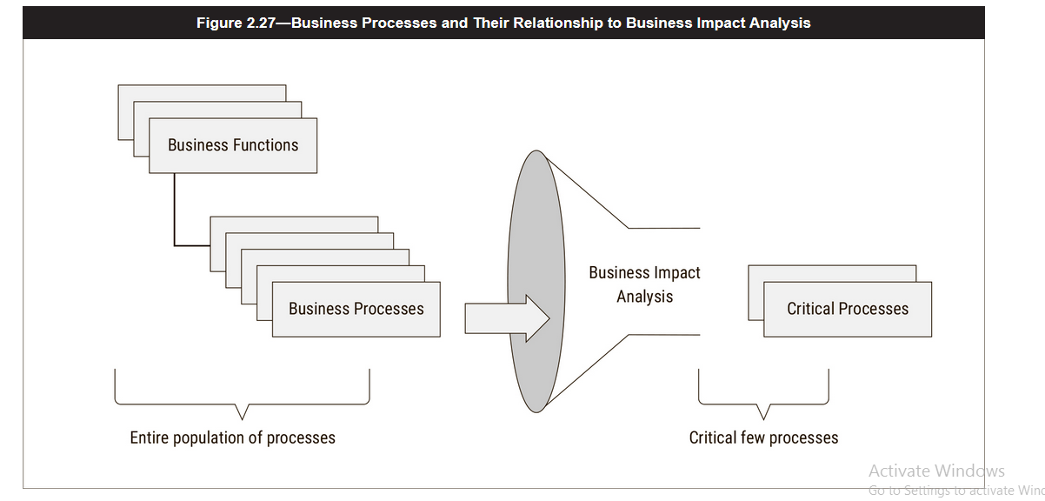

Slide 49
CRITICALITY ANALYSIS
Classification of System , process and operation
Critical :
  These functions cannot be performed unless they are replaced by identical capabilities.
  Critical applications cannot be replaced by manual methods.
  Tolerance to interruption is very low; therefore, cost of interruption is very high.
Vital:
  These functions can be performed manually, but only for a brief period of time.
  There is a higher tolerance to interruption than with critical systems and, therefore, somewhat lower costs of interruption, provided that functions are restored within a certain time frame (usually five days or less).
Sensitive:
  These functions can be performed manually, at a tolerable cost and for an extended period of time.
Non-sensitive:
  These functions may be interrupted for an extended period of time, at little or no cost to the company, and require little or no catching up when restored.

Slide 50
Beyond Business Impact
  The focus and purpose of the BIA process is to ultimately determine the impact that would be felt should an incident occur which disrupts normal operations.
  The BIA process should also be used to inform the business continuity/organizational resiliency planning efforts, to ensure that the appropriate controls needed to safeguard those business functions and their supporting resources.
  Additionally, the BIA should serve as a starting point to guided IT disaster recovery planning activities, as well as verify RTO, recovery point objectives (RPO), service delivery objectives (SDO) and maximum tolerable downtime (MTD).
  Figure 2.28 further explains the relationship among these elements.

Slide 51
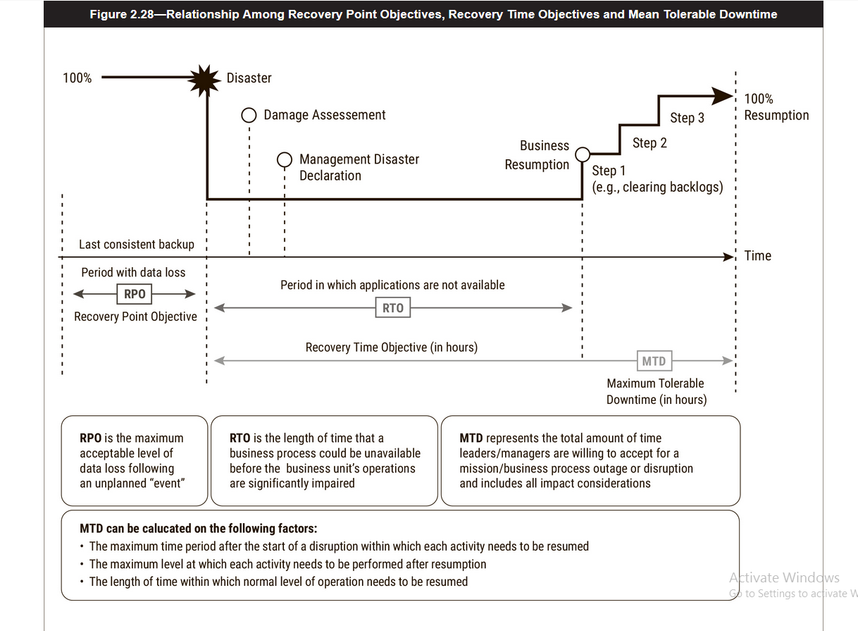

Slide 52
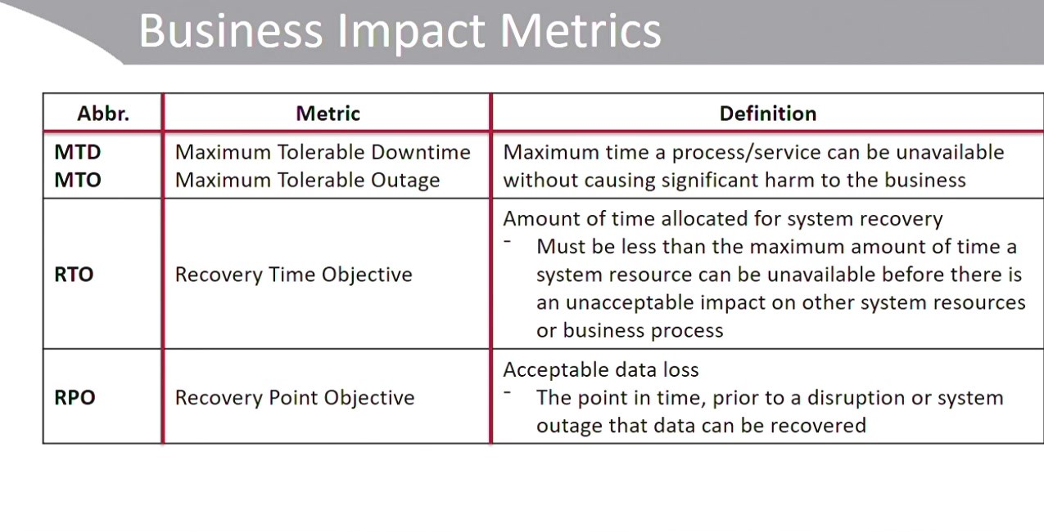

Slide 53
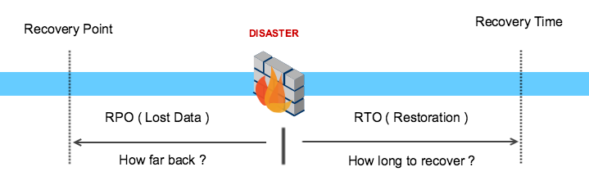
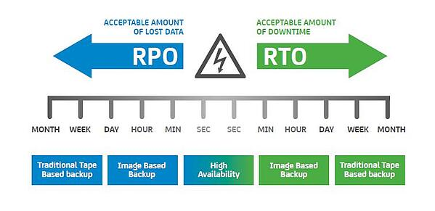

Slide 54
Business Impact Analysis and Risk Assessment
  there are a few key distinctions between a BIA and a risk assessment (figure 2.29):
  A BIA is used to establish requirements for business continuity efforts; this includes identifying resource dependencies, tracing those requirements to impacts and justifying investments that are associated with the disruption of services.
  A risk assessment focuses on understanding the threats faced by an enterprise, the frequency (likelihood/probability) and impact (loss magnitude/consequences) associated with those threats to properly respond to the risk, with the goal to decrease the likelihood or impact the organization could experience.

Slide 55
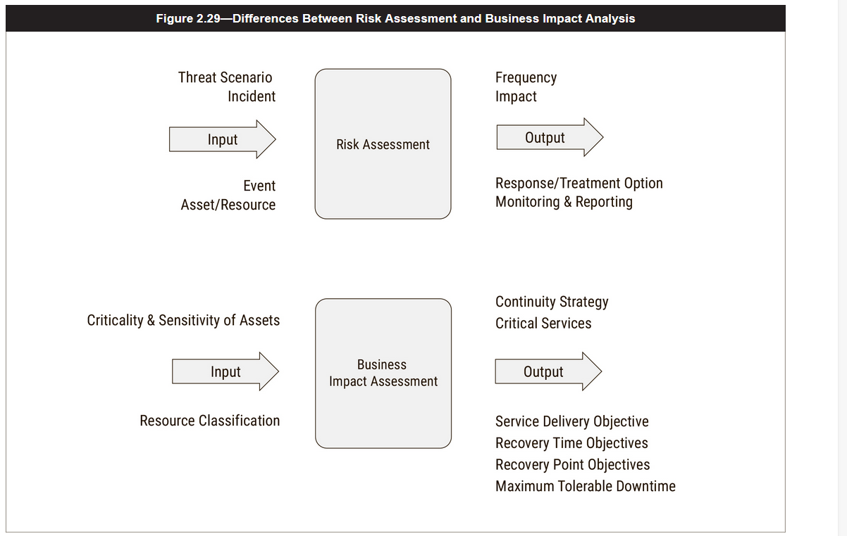

Slide 56
Reporting Risk Assessment Results
Results of the risk assessment are reported to the key managers in the organization.
Most organizations have their own methods for generating formal reports, including, detailed reports that describe risk on a generalized basis or map IT risk to business processes.
Determine risk and frame it in such a manner that senior executives and managers can understand, particularly in terms of business cases, to communicate the results of risk assessment.

Slide 57
Risk Determination
Risk determination depends on the organization’s risk management strategy, on the methodology used, and on the organization’s risk culture, appetite, and tolerance.
The risk assessor’s job is also to determine and express risk as an impact on business processes.
Risk determination reported as both qualitative and quantitative values since cost is only one of the measurements of risk.
Risk should be determined based upon impact and likelihood values after existing controls are taken into account.
After a viable risk response option is selected (accepting it, mitigating it, transferring it, or avoiding it), there will still be risk left over; called residual risk and will always exist.
The organization must determine whether the residual risk falls within the organization’s ranges for risk tolerance and appetite.

Slide 58
Communicating Risk Analysis
Risk assessor is charged with briefing to managers and executives within the entire organization.
This can be challenging simply because, unless their daily duties involve risk management many of the people receiving this information won’t quite understand the purpose for the assessment, the methodology used, and how significant the findings really are
They should understand how IT risk relates to any impact on their business processes and operations.
IT risk should be communicated in such a way that the different asset, risk, and control owners are made aware of how it affects the confidentiality, integrity, and availability of the information systems and data to support their business processes.
Stakeholders should also be educated on the different risk response options available since often they will be responsible for resourcing these options from their own budgets and implementing them.

Slide 59
Results Documentation
Documentation includes presenting an executive summary and briefly describes the risk analysis results, as well as the general aspects of the assessment itself, including scope, limitations, assets assessed, information owners, risk owners, control owner.
Documentation could produce detailed technical findings, such as those that might result from threat or vulnerability assessments.
Documentation involves updating the risk profile for the organization at the organizational level; and processes, systems, and other resources or assets at the lower levels involving
Documentation should be carefully controlled and it should be considered sensitive information for the organization.

Slide 60
Updating the Risk Register
Risk Register is a living document it should be periodically updated as risk conditions change.
  Continuous assessments will provide updated information that should be included in the risk register
  Information about ongoing risk response actions applied to the risk.
Whether the risk register is in the form of an electronic database, spreadsheet, or other type of document, it should be easy to read and readily accessible by managers or risk owners.
It also should be considered a sensitive, access-controlled document.

Slide 61
Thank you

